Slide 1

Scene 1 – Woman looking for ingredients in the fridge

Slide 2
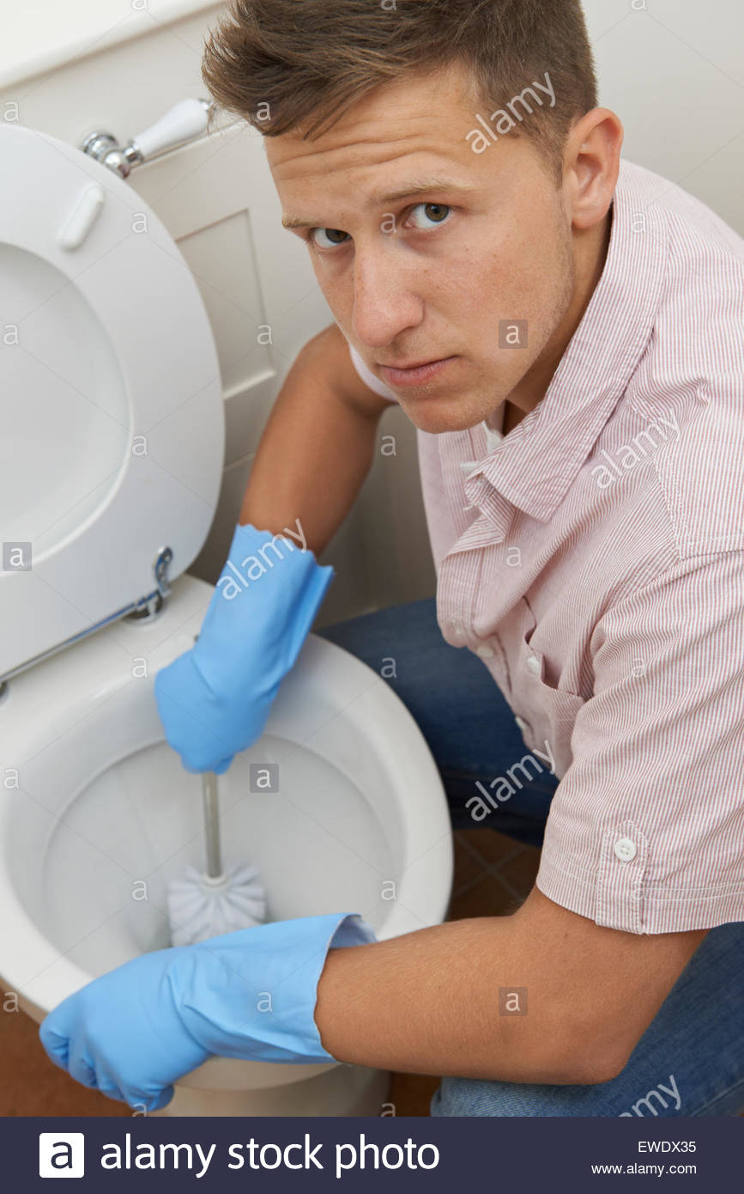
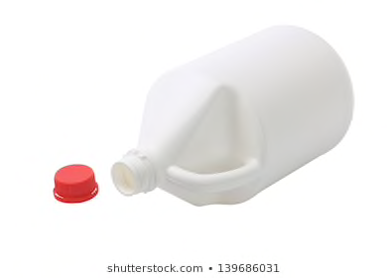
Scene 2 – Man discovering the bleach bottle is empty white trying to clean the toilet

Slide 3

Scene 3 – Me reassuring the audience that we have the perfect solution

Slide 4

Scene 4 – Me in a business suit and glasses telling the camera about the product

Slide 5

Scene 5 - Disclaimer

